Slide 1
GENETICALLY MODIFIED ORGANISMS

Slide 2
What are GM’s?
Organism one that has been altered through recombinant DNA technology
Involves either the combining of DNA from different genomes or the insertion of foreign DNA into a genome
The most common genetically modified (GM) organisms are crop plants
Microbes are the first organisms to be genetically modified

Slide 3
What is not a GMO?
Does not include
Mutants.
Fusion of animal cells unless the product can form an animal.
Organisms formed by natural DNA transfer.
Notes:
5

Slide 4
How transgenic organisms work…
Three Main Methods…
DNA Microinjection
A foreign gene is directly injected into a fertilized egg that is put into a female animal that acts as a surrogate mother for the egg.
Retrovirus-Mediated Gene Transfer
A retrovirus is a virus that attaches to an organism’s DNA and changes it to include a new characteristic. Scientists expose ordinary cells to a retrovirus when they are trying to create transgenic animals.
Embryonic Stem Cell-Mediated Gene Transfer
Stem cells are blank cells that can turn into any type of cell. Scientists modify these cells, and then add them to an embryo, which is a fertilized egg that develops and grows until it hatches or is born.

Slide 5
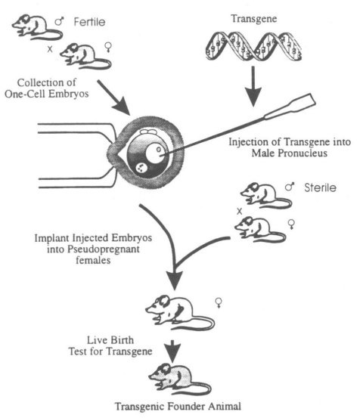
DNA MICROINJECTION
Most commonly used method
Need to check mouse for DNA , RNA and protein ( by some specific assay method)
Expression will vary in transgenic offspring: due to position effect and copy number

Slide 6
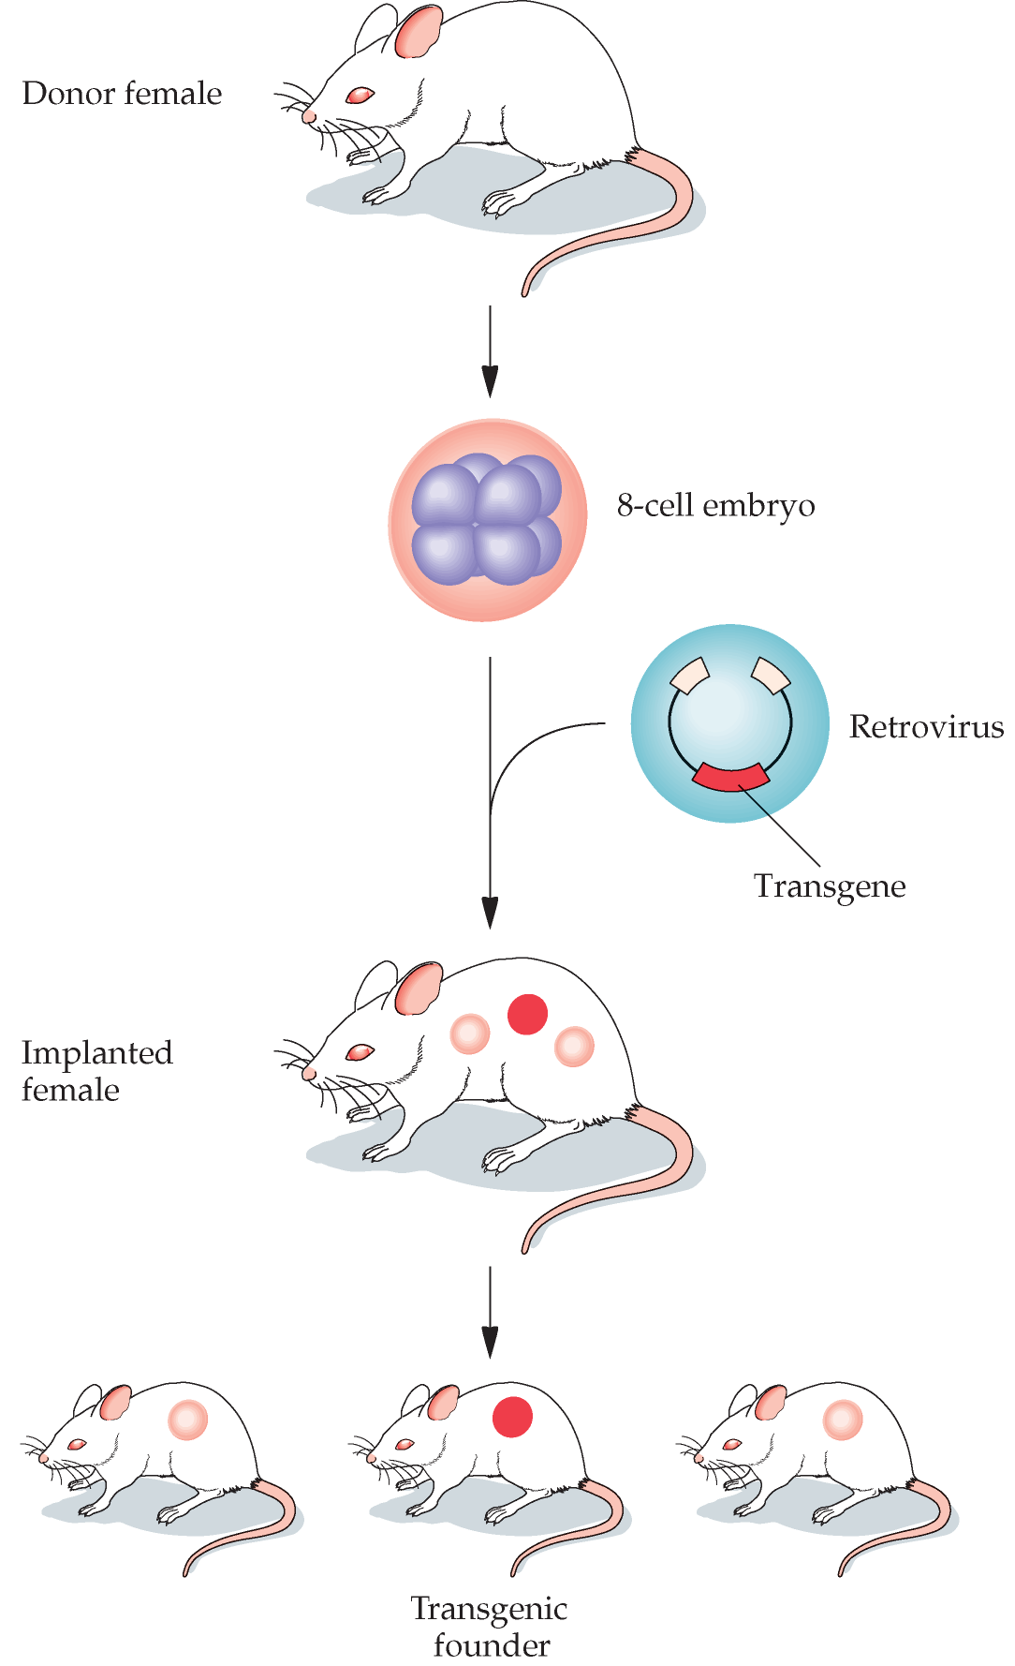
RETROVIRUS-MEDIATED GENE TRANSFER
Retroviral vectors can be used to create transgenic animals

Slide 7
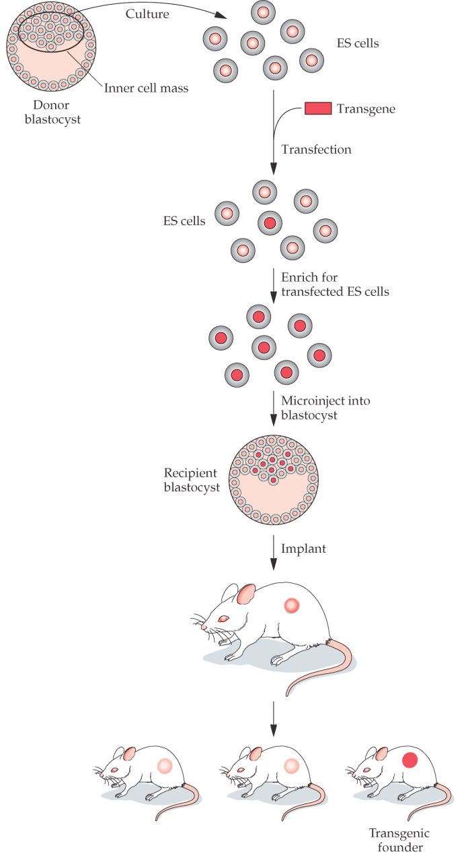
EMBRYONIC STEM CELL-MEDIATED GENE TRANSFER
Genetically engineered
embryonic stem (ES) cells can be used to create transgenic animals
This method allow for
gene targeting via
homologous
recombination.

Slide 8
THE MOST COMMON TYPES OF GMO’S
FOODS
Crops are modified to develop resistance to
herbicides and increase their nutrient
content, for example corn and soybeans .
Fruits are modified to make them ripen later.
This help them available fresh in marketplace
during a longer time or for fruits that ripen
after being picked, make it easier to transport
them.

Slide 9
THE MOST COMMON TYPES OF GMO’S
MEDICINES
These can be produced cheaper and easier
some are: insulin, thyroid hormones and the
Hepatitis B vaccine
GM Bacteria’s have been particularly important in
producing large amounts of pure human proteins
for use in medicine like clotting factors for
hemophilia and human growth hormones to treat
dwarfism

Slide 10
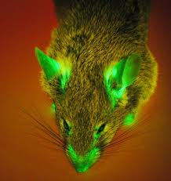
OTHER TYPES OF GMO’S ARE
MAMMALS
Research human diseases
(To develop animal models for many diseases.)
Produce industrial or consumer products
(pharmaceutical products or tissue implantation)
Enhance production or food quality traits
(faster growth fish, pigs that digest food more
efficiently)
Improve animal health(disease resistance)

Slide 11
GENETICALLY MODIFIED PIGS
MEDICINE
Production of pharmaceuticals (human hemoglobin in blood of pigs for treating Trauma patients)
Organs for Xenotransplantation into humans
development of models for human diseases

Slide 12
Applications
To research human diseases (for example, to develop animal models for these diseases)
To produce industrial or consumer products
To produce products intended for human therapeutic use (pharmaceutical products or tissue)
To enhance production or food quality traits (faster growing fish, pigs that digest food more efficiently)
To improve animal health (disease resistance)

Slide 13
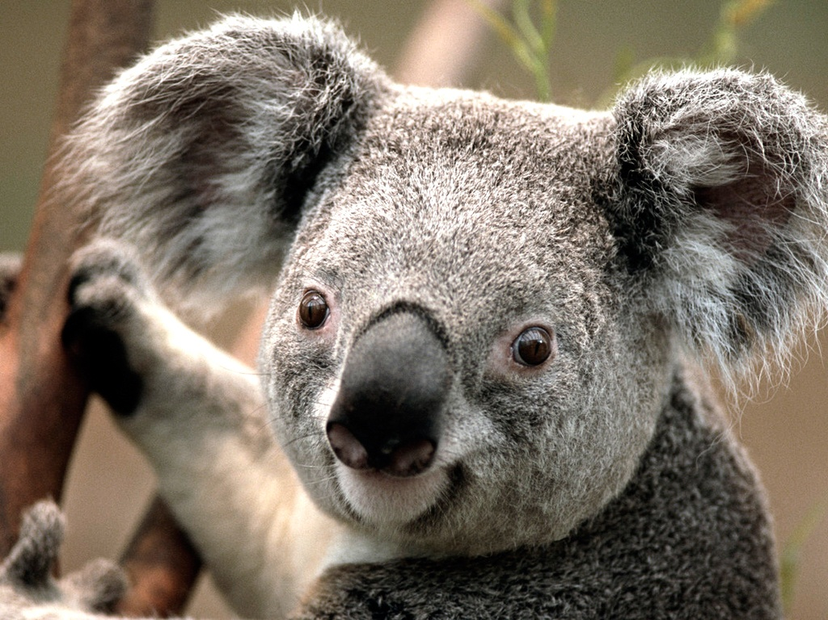
Thank You

